Slide 1
Stages of AI-
Rule based to Agentic AI
Premalatha T

Slide 2

WHO AM I?
LinkedIn:https://www.linkedin.com/in/premalatha-t-b21018128/
Data Science ,AIML
Data Analysis ,SQL,Pyspark
Data Visualization ,PowerBI,Tableau
Natural Language Processing (NLP)
Computer Vision
Generative AI,Prompt Engineering
BigData and Data Engineering

Slide 3
TECHNICAL EXPERTISE
Data Science & Analytics
Python | SQL | R | Power BI | Tableau | Data Science | Machine Learning | Deep Learning | NLP | Computer Vision
Data Engineering & Big Data
Apache Spark | PySpark | Big Data | Data Engineering
Generative AI & LLM Engineering
Generative AI | LLMs | OpenAI | OpenAI SDK | Azure OpenAI | Anthropic Claude | Claude API/SDK | Gemini | Gemini API/SDK | ChatGPT | Microsoft Copilot | Prompt Engineering | Fine-Tuning

Slide 4
TECHNICAL EXPERTISE
Generative AI & LLM Engineering
Generative AI | LLMs | OpenAI | OpenAI SDK | Azure OpenAI | Anthropic Claude | Claude API/SDK | Gemini | Gemini API/SDK | ChatGPT | Microsoft Copilot | Prompt Engineering | Fine-Tuning
Agentic AI & AI Frameworks
AI Agents | Agentic AI | Google ADK | MCP | LangChain | LangGraph | CrewAI | AutoGen | n8n | LlamaIndex
RAG, AI Evaluation & Security
RAG | Vector Databases | Embeddings | Hugging Face | Sentence Transformers | AI Evaluation | Responsible AI | AI Security

Slide 5
TECHNICAL EXPERTISE
Data Science & Analytics
Python | SQL | R | Power BI | Tableau | Data Science | Machine Learning | Deep Learning | NLP | Computer Vision
Data Engineering & Big Data
Apache Spark | PySpark | Big Data | Data Engineering
AI Application Development & Deployment
FastAPI | Streamlit | AI Application Development | AI Deployment | MLOps | AIOps
Cloud & DevOps
Azure | AWS | GCP | OCI | Git | GitHub Copilot | CI/CD | Docker | Kubernetes

Slide 6
What is Artificial Intelligence?
Artificial Intelligence (AI) refers to the ability of machines or computer systems to perform tasks that normally require human intelligence.

Slide 7
AI Around Us
Google Search
Maps Navigation
Netflix Recommendations
Amazon Product Suggestions
Face Unlock
Voice Assistants
Spam Detection
Grammar Correction
Banking Fraud Detection
Healthcare Diagnosis Support

Slide 8
How many AI applications have you already used before reaching office today

Slide 9
AI is Like a Student
Human Student
Learns from books
Makes mistakes
Improves through practice

Slide 10
AI is Like a Student
AI Model
Learns from data
Makes predictions
Improves with better training
Important Message
AI does not "think."
It predicts the most probable answer.

Slide 11
Activity
Create a realistic image of a software engineer working in an office.

Slide 12
Create an image of a man writing with Left hand

Slide 13
Image Generation
Create an image of a doctor treating a patient.
Then ask participants:
Now modify the prompt.
Examples
Female doctor
Rural hospital
Pediatrician
Wearing PPE
Elderly patient
Wheelchair user

Slide 14
According to our communication sofar,
Which hindi movie character do you relate me with? Justify.

Slide 15


Slide 16


Slide 17
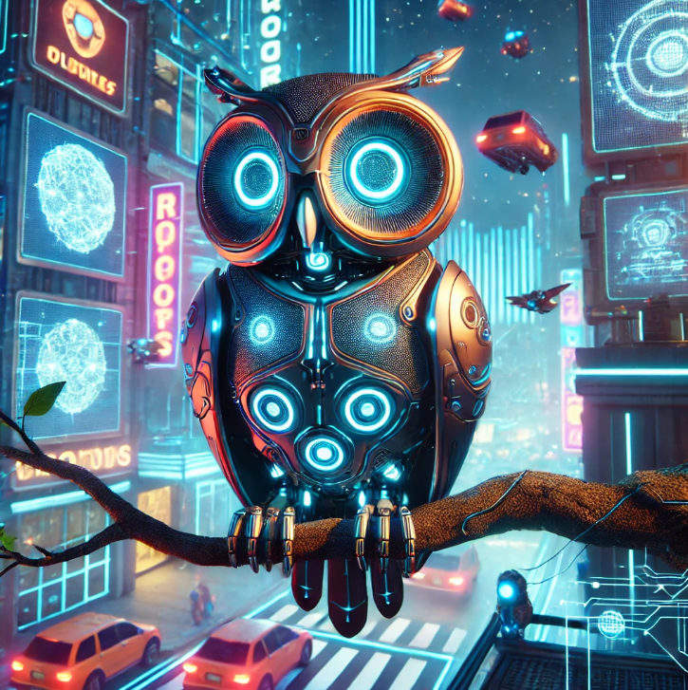

Slide 18


Slide 19
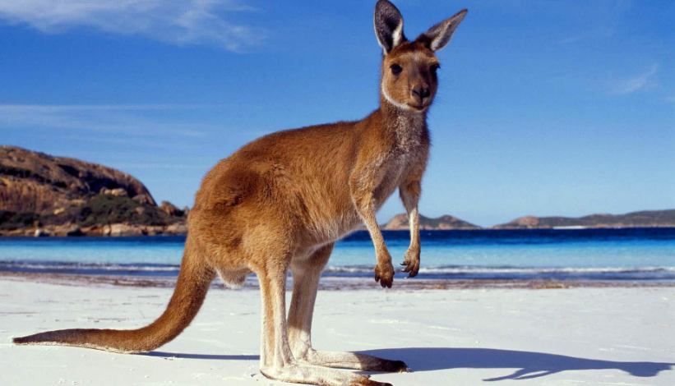

Slide 20


Slide 21
Why AI Sometimes Fails
Bias
Hallucination
Outdated knowledge (depending on the model)
Lack of common sense
Ambiguous prompts
No emotions
Cannot verify every answer
Golden Rule
AI should assist human decision-making—not replace it.

Slide 22
Why AI Sometimes Fails
Explain Artificial Intelligence like I am a 10-year-old.
Explain Artificial Intelligence for a CEO in one paragraph.
Explain Artificial Intelligence for a doctor.

Slide 23
Narrow AI (Weak AI)
Narrow AI is designed to perform one specific task extremely well.
Characteristics
Specialized
Task-specific
No understanding beyond its domain
Needs human instructions
Cannot transfer knowledge

Slide 24
Narrow AI (Weak AI)
Examples
Face Unlock
Spam Detection
Google Translate
Netflix Recommendation
Medical Image Detection

Slide 25
Artificial General Intelligence (AGI)
What is General AI?
General AI (AGI) refers to an AI system capable of performing any intellectual task that a human can perform.
It would be able to
Learn new skills independently
Apply knowledge across domains
Reason
Plan
Solve unfamiliar problems
Adapt to new environments

Slide 26
Artificial General Intelligence (AGI)
Can ChatGPT repair your car?
Can it cook dinner?
It is powerful but still Narrow AI.

Slide 27
Agentic AI
Agentic AI goes beyond generating answers.
It can
Understand a goal
Create a plan
Use tools
Make decisions
Execute tasks
Monitor progress
Adjust when something changes

Slide 28
Activity: Travel Agent Example
Plan a 3-day vacation to Goa with a budget of ₹25,000.
ChatGPT only generated a plan.
An Agentic AI would also
Search flights
Compare hotels
Book tickets
Add calendar events
Monitor flight delays
Notify changes
This is the difference between answer generation and task execution.

Slide 29
Agentic AI in Business
Employee says "Prepare next week's customer meeting."
An AI Agent could
✔ Search CRM
✔ Read previous emails
✔ Create PowerPoint
✔ Schedule meeting
✔ Invite attendees
✔ Summarize customer issues
✔ Generate meeting notes afterward
Discussion
AI is becoming a digital teammate rather than just a chatbot.

Slide 30
Evolution of AI Systems
How AI Has Evolved
Artificial Intelligence has evolved from rule-based systems to autonomous AI agents capable of reasoning and taking actions.
AI Evolution Journey
Rule-Based Systems → Machine Learning → Deep Learning → Generative AI → Agentic AI
Key Message
AI has evolved from following instructions to learning, creating, and now acting autonomously.

Slide 31
Stage 1: Rule-Based AI (1950s–1990s)
AI Based on Rules
Early AI systems relied on predefined rules written by humans.
How It Works
Input → Rules → Output
Example:
If balance < ₹500 → Low balance alert

Slide 32
Stage 1: Rule-Based AI (1950s–1990s)
No learning
Deterministic
Easy to explain
Limited flexibility
Examples
Tax calculators
Early expert systems
Rule-based chatbots

Slide 33
Stage 2: Machine Learning
Example
Rather than coding every fraud rule:
Train a model on millions of transactions.
The model identifies suspicious patterns.
Applications
Spam detection
Credit scoring
Product recommendations
Customer churn prediction

Slide 34
Stage 3: Deep Learning
Learning Complex Patterns
Deep Learning uses artificial neural networks inspired by the human brain.
What Changed?
AI became much better at:
Image recognition
Speech recognition
Language understanding
Video analysis

Slide 35
Stage 3: Deep Learning
Examples
Face recognition
Self-driving perception
Medical image analysis
Voice assistants
Activity
Show an image and ask participants:
"Can AI identify whether this is a cat or a dog?"
Discuss how deep learning learns visual patterns instead of handcrafted rules.

Slide 36
Stage 4: Generative AI
AI That Creates
Generative AI doesn't just analyze data—it creates new content.
It Can Generate
Text
Images
Code
Audio
Video
Presentations

Slide 37
Stage 4: Generative AI
Examples
ChatGPT
Image generation tools
AI coding assistants
AI presentation tools

Slide 38
Stage 4: Generative AI
Prompt:
"Create a professional email requesting leave.“
Change the prompt:
"Make it formal."

Slide 39
Stage 5: Agentic AI
AI That Acts
Agentic AI moves beyond generating answers.
It can:
Plan
Reason
Use tools
Make decisions
Complete multi-step tasks
Monitor progress

Slide 40
Stage 5: Agentic AI
Organize next week's customer meeting."
The AI agent can:
Read emails
Find available meeting slots
Create an agenda
Generate presentation slides
Send calendar invitations

Slide 41
Hands-On Demonstration
Challenge: Observe the Evolution in Action
Use the same business scenario across different AI stages:
Scenario: "A customer complains about a delayed product."
Rule-Based AI: Sends a predefined apology message.
Machine Learning: Predicts whether the customer is likely to churn.
Deep Learning: Analyzes the sentiment of the complaint.
Generative AI: Drafts a personalized response email.
Agentic AI: Drafts the email, checks order status, initiates a refund if eligible, updates the CRM, and schedules a follow-up task.

Slide 42
What is Data?

Slide 43
What is DATA?
Data is a collection of facts, figures, observations, or measurements that can be analyzed to gain insights.
It can be structured (like tables in a database) or unstructured (like text, images, or videos).
Data is crucial for decision-making in businesses, research, and technology.

Slide 44
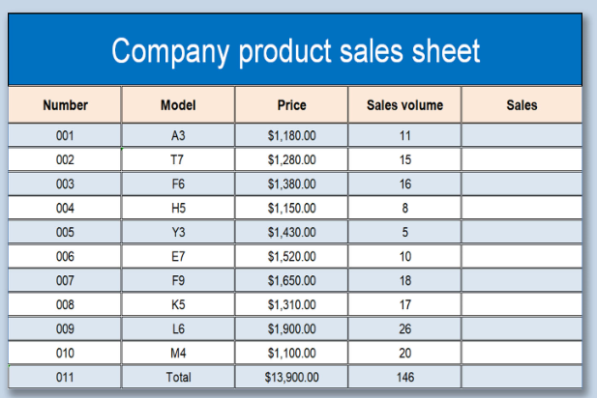
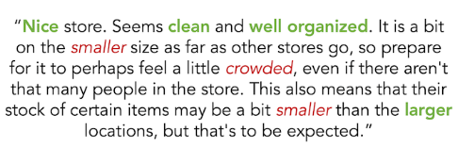

Slide 45
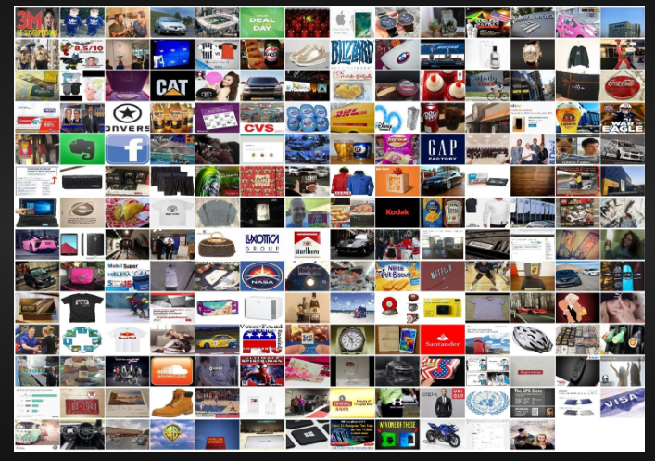
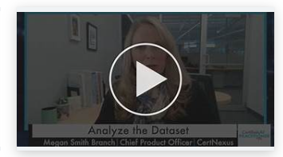
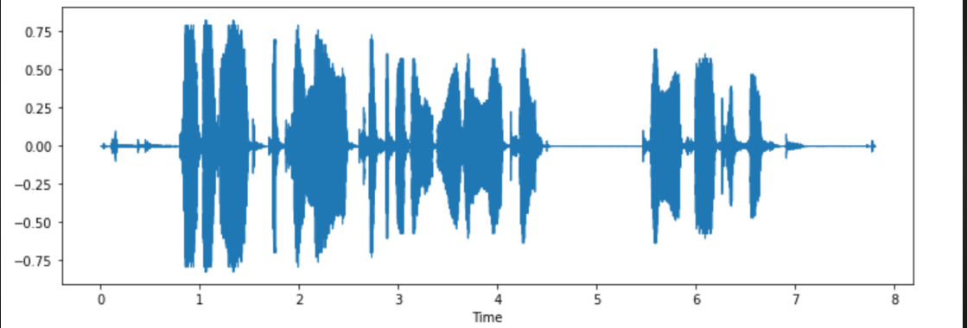

Slide 46
Structured or Unstructured?
Customer purchase history in a database
Video recordings of stock market news
Excel sheet with employee salary data
WhatsApp chat messages
Weather sensor readings

Slide 47
When to Use ML, CV, NLP, and DL?
Each technique—Machine Learning (ML), Computer Vision (CV), Natural Language Processing (NLP), and Deep Learning (DL)—is used based on the type of data and the problem being solved.

Slide 48
Machine Learning (ML)
Use ML when:
You have structured/tabular data (e.g., sales records, customer transactions).
You need to make predictions, classifications, or clustering.
Examples:
Predicting loan approvals (Classification)
Customer churn prediction
Fraud detection in banking
Recommender systems (Netflix, Amazon)

Slide 49
Computer Vision (CV)
Use CV when:
You are working with images or videos.
You need to analyze, classify, or generate images.
Examples:
Face recognition in security systems
Object detection in self-driving cars
Medical image analysis (e.g., detecting tumors in MRI scans)
Defect detection in manufacturing

Slide 50
Natural Language Processing (NLP)
Use NLP when:
You are working with text or speech data.
You need to understand, generate, or translate language.
Examples:
Chatbots and virtual assistants (Siri, Alexa)
Sentiment analysis of customer reviews
Machine translation (e.g., Google Translate)
Email spam detection

Slide 51
Deep Learning (DL)
Use DL when:
Your dataset is large and complex (images, speech, unstructured text).
Traditional ML models do not perform well.
You need high accuracy and have computational power (GPUs/TPUs).
Examples:
Autonomous driving (Self-driving cars)
Image generation (Deepfake technology)
Speech recognition (Google Assistant, Alexa)
Large Language Models (ChatGPT, Gemini,COPILOT)

Slide 52
Problem Statements
A bank wants to predict whether a customer will default on a loan based on transaction history and demographics.
A company wants to classify customer support emails as complaints, inquiries, or feedback.
A factory needs an AI system to detect defects in manufactured products by analyzing images.

Slide 53
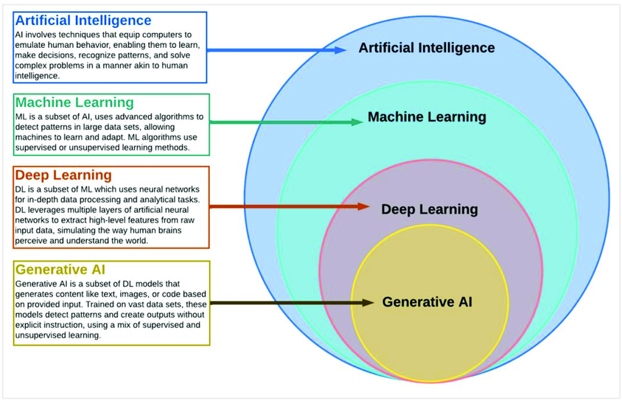

Slide 54
AI vs ML vs DL vs Generative AI
AI, Machine Learning, Deep Learning, and Generative AI are not competing technologies—they are nested technologies, where each builds upon the previous one.
Artificial Intelligence (AI)
│
├── Machine Learning (ML)
│ │
│ └── Deep Learning (DL)
│ │
│ └── Generative AI (GenAI)
Key Message
Every Generative AI model uses Deep Learning, every Deep Learning model is a Machine Learning model, and every Machine Learning model is part of Artificial Intelligence.

Slide 55
Types of Analytics
In today's data-driven world, information is king. But raw data itself isn't enough.
We need to analyze it to extract insights and make informed decisions

Slide 56






Slide 57
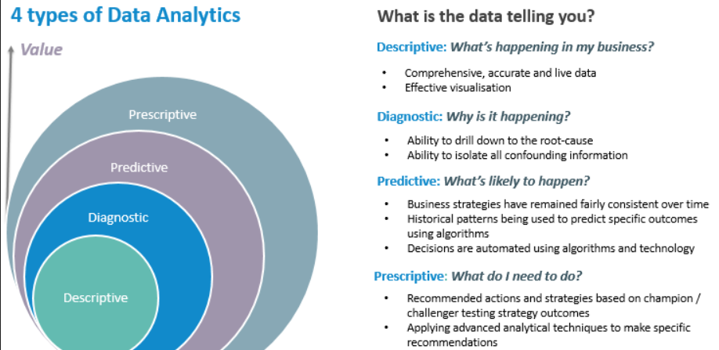

Slide 58
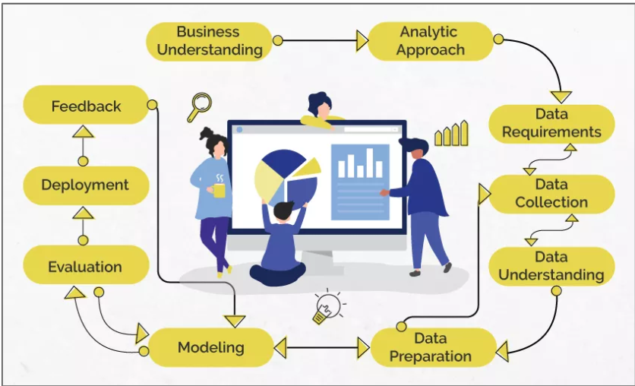
Data Science/Machine Learning

Slide 59
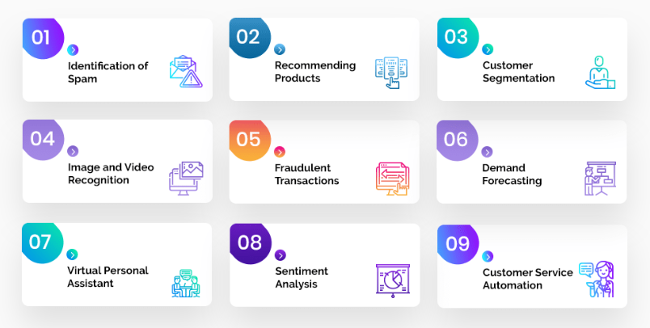
Problem Statement

Slide 60
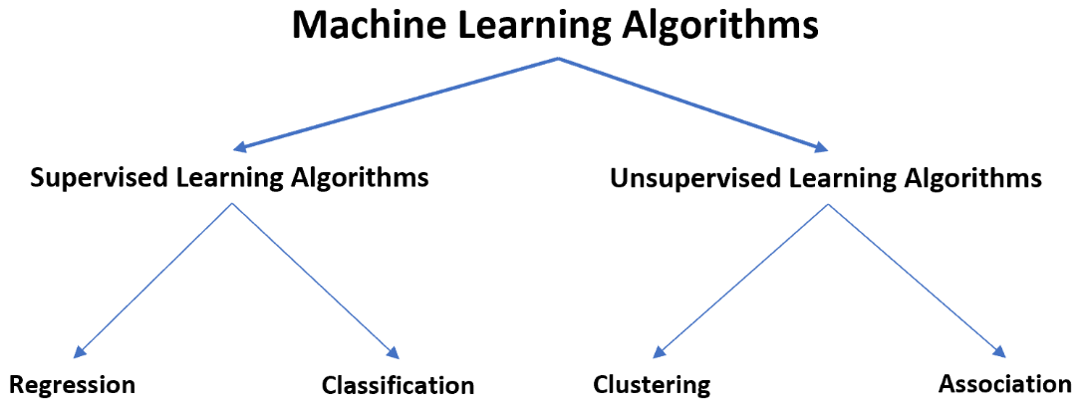

Slide 61
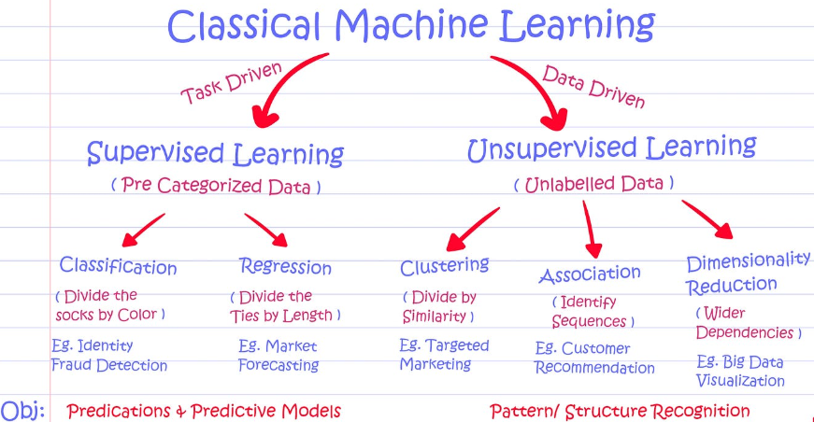

Slide 62
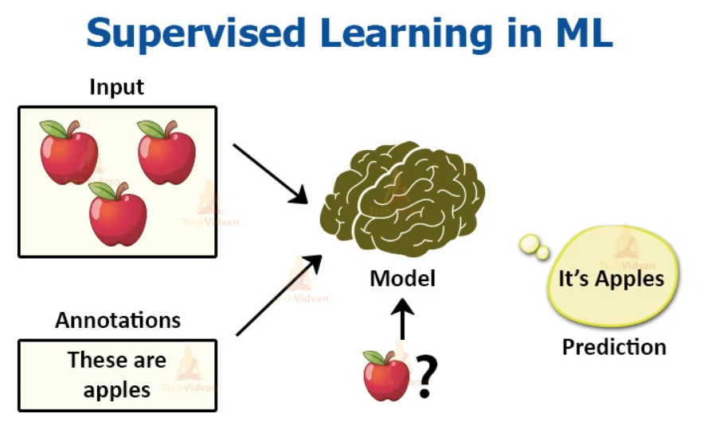

Slide 63
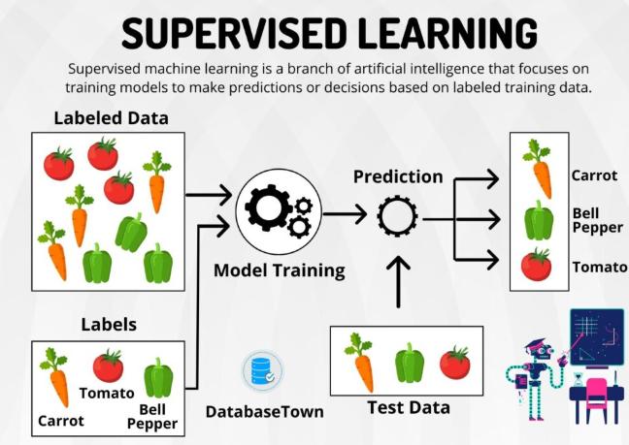

Slide 64
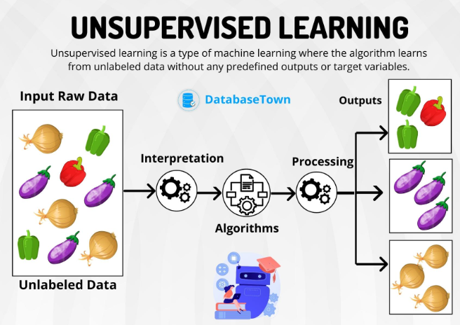

Slide 65
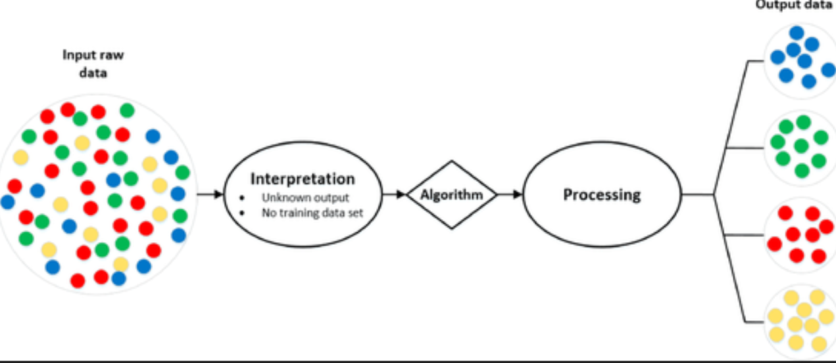
Analytic Approach

Slide 66
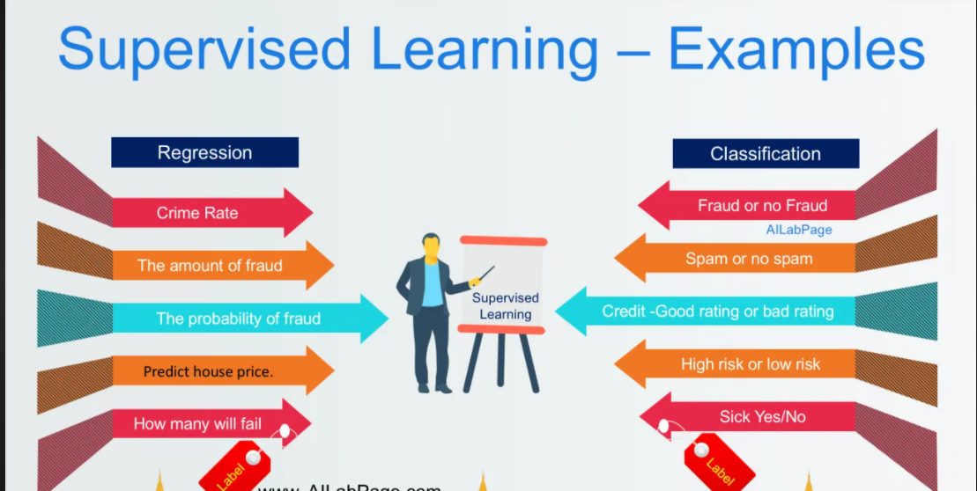
Supervised Learning

Slide 67
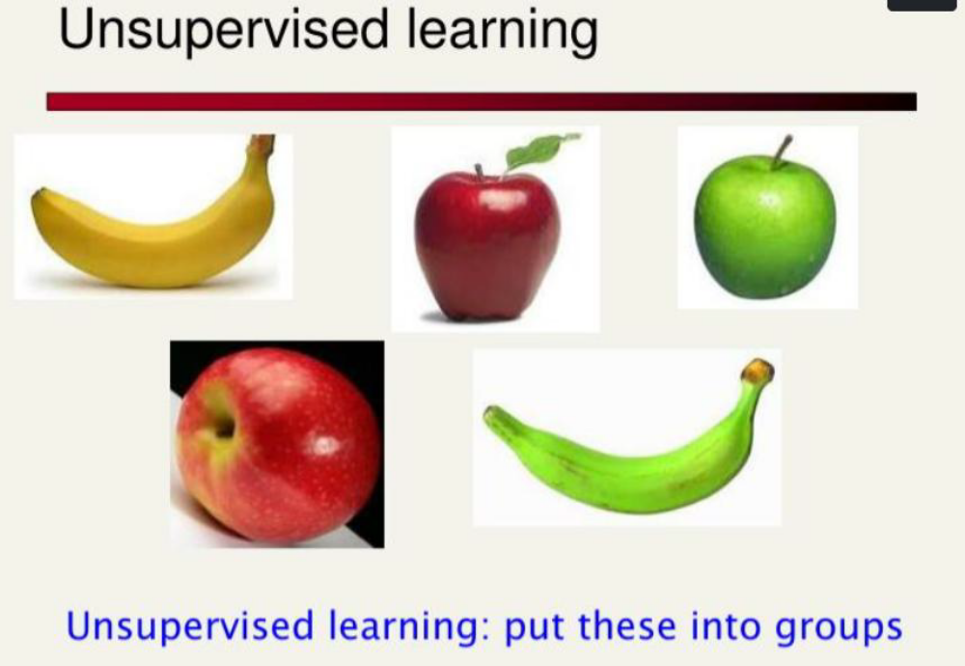

Slide 68
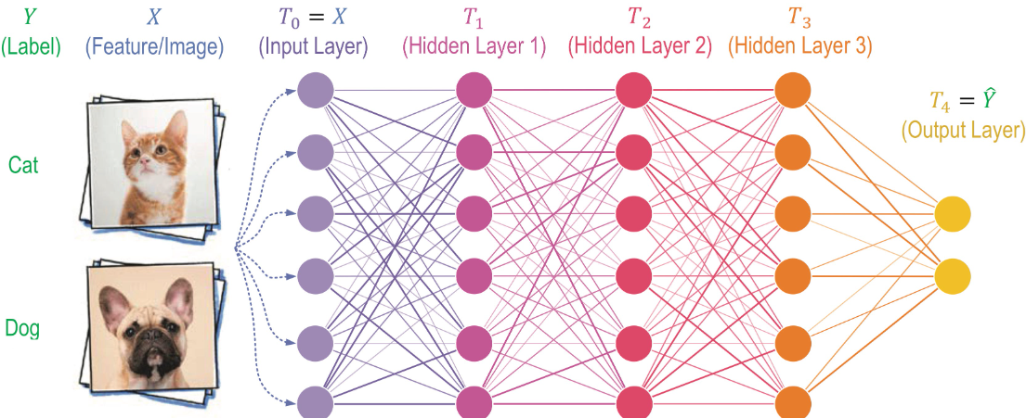

Slide 69
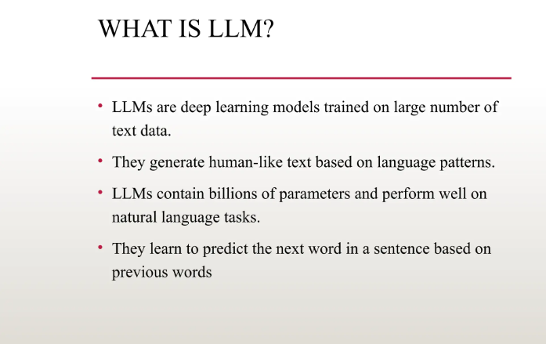

Slide 70
